Slide 1

Files and Streams
Using Streams, Files, Serialization
Advanced
Java
SoftUni Team
Technical Trainers
Software University
http://softuni.bg
<number>

Slide 2
Questions?
sli.do
#java-fund
<number>

Slide 3
Table of Content
Streams Basics
Opening a File Stream
Closing a File Stream
Types of Streams
Combining Streams
Files and Directories
Serialization
<number>

Slide 4


What is Stream?
Streams are used to transfer data
We open a stream to:
Read a file
Write to a file
1100 1001 1001
Stream
<number>

Slide 5

Streams Basics
Two fundamental types of streams:
1100 1001 1001
Input Stream
Streams are unidirectional!
1100 1001 1001
Output Stream
<number>

Slide 6
Opening a File Stream
String path = "C:\\input.txt";
FileInputStream fileStream = new FileInputStream(path);
int oneByte = fileStream.read();
while (oneByte >= 0) {
System.out.print(oneByte);
oneByte = fileStream.read();
}
Returns -1 if empty
<number>

Slide 7


Closing a File Stream
Using try-catch-finally
try {
InputStream in = new FileInputStream(path)
} catch (IOException e) {
// TODO: handle exception
} finally {
if (in != null) {
in.close();
}
}
close() can also throw an exception
10101
Always free resources!
<number>

Slide 8
Closing a File Stream (2)
Using try-with-resources
try (InputStream in = new FileInputStream(path)) {
int oneByte = fileStream.read();
while (oneByte >= 0) {
System.out.print(oneByte);
oneByte = fileStream.read();
}
} catch (IOException e) {
// TODO: handle exception
}
10101
<number>

Slide 9
Problem: Read File
You are given a file
Read and print all of its contents as a sequence of bytes
Submit in Judge only the output of the program
Two households, both alike in dignity, In fair Verona, where we lay our scene,
1010100 1110111 1101111 100000 1101000 1101111 1110101 1110011 1100101 1101000…
<number>

Slide 10

Solution: Read File
String path = "D:\\input.txt";
try (InputStream in = new FileInputStream(path)) {
int oneByte = in.read();
while (oneByte >= 0) {
System.out.prinf("%s ", Integer.toBinaryString(oneByte));
oneByte = in.read();
}
}
catch (IOException e) {
e.printStackTrace();
}
<number>

Slide 11
Problem: Write to File
Read a file and write all its content while skipping any
punctuation (skip ',', '.', '!', '?')
Submit in Judge only the output of the program
Two households, both alike in dignity.
In fair Verona, where we lay our scene.
Two households both alike in dignity
In fair Verona where we lay our scene
<number>

Slide 12


Solution: Write to File
String inputPath = "D:\\input.txt";
String outputPath = "D:\\output.txt";
List<Character> symbols = new ArrayList<>();
Collections.addAll(symbols, '.', ',', '!', '?');
// continues…
<number>

Slide 13
Solution: Write to a File (2)
try (InputStream in = new FileInputStream(inputPath);
OutputStream out = new FileOutputStream(outputPath)) {
int oneByte = 0;
while ((oneByte = in.read()) >= 0) {
if (!symbols.contains((char)oneByte)) {
out.write(oneByte);
}
}
} // TODO: handle exceptions
<number>

Slide 14

Basic Stream Types in Java
Byte and Character

Slide 15
Byte Stream
Byte streams are the lowest level streams
Byte streams can read or write one byte at a time
All byte streams descend from InputStream and OutputStream
InputStream
100101 | 111111 | 100011 | -1
OutputStream
100101
111111
100011
<number>

Slide 16
Problem: Copy Bytes
Read a file and copy its contents to another text file
Write characters as bytes in decimal
Write every space or new line as it is, e.g. as a space or new line
T
w
o
space
Two households, both alike in dignity.
In fair Verona, where we lay our scene.
84119111 10411111711510110411…
73110 10297105114 861011141111109744 1…
<number>

Slide 17
Solution: Copy Bytes
int oneByte = 0;
while ((oneByte = in.read()) >= 0) {
if (oneByte == 10 || oneByte == 32) {
out.write(oneByte);
} else {
String digits = String.valueOf(oneByte);
for (int i = 0; i < digits.length(); i++)
out.write(digits.charAt(i));
}
}
<number>

Slide 18
Character Streams
All character streams descend from
FileReader and FileWriter
String path = "D:\\input.txt";
FileReader reader = new FileReader(path);
<number>

Slide 19
Combining Streams
Character streams are often "wrappers" for byte streams.
FileReader uses FileInputStream
FileWriter uses FileOutputStream
String path = "D:\\input.txt";
Scanner reader =
new Scanner(new FileInputStream(path));
Wrapping a Stream
<number>

Slide 20
Problem: Extract Integers
Read a file and extracts all integers in a separate file
Get only numbers that are not a part of a word
Submit in Judge only the output of the program
2 households, 22 alike in 3nity, In fair Verona, where we lay our scene
2
22
<number>

Slide 21
Solution: Extract Integers
Scanner scanner =
new Scanner(new FileInputStream(inputPath));
PrintWriter out =
new PrintWriter(new FileOutputStream(outputPath));
while (scanner.hasNext()) {
if (scanner.hasNextInt())
out.println(scanner.nextInt());
scanner.next();
}
<number>

Slide 22
Buffered Streams
Reading information in chunks
Significantly boost performance
F i l e s a n d
46 | 69 | 6c | 65 | 73 | 20 | 61 | 6e | 64
Position
Buffer
46 | 69
6c | 65
73 | 20
61 | 6e
64
Reduces the number of interactions
<number>

Slide 23

Problem: Write Every Third Line
Read a file and write all lines which number is divisible by 3 in a separate file
Line numbers start from one
Two households, both alike in dignity, In fair Verona, where we lay our scene, From ancient grudge break to new mutiny…
10101
<number>

Slide 24
Solution: Write Every Third Line
try (BufferedReader in =
new BufferedReader(new FileReader(inputPath));
PrintWriter out =
new PrintWriter(new FileWriter(outputPath))) {
int counter = 1;
String line = in.readLine();
while (line != null) {
if (counter % 3 == 0)
out.println(line);
counter++;
line = in.readLine();
}
} // Catch Exception
<number>

Slide 25
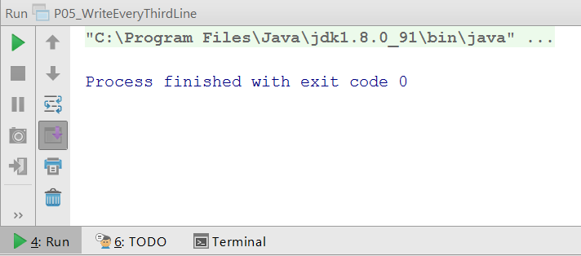
Command Line I/O
Standard Input – System.in
Standard Output – System.out
Standard Error – System.err
Input Stream
Scanner scanner = new Scanner(System.in);
String line = scanner.nextLine();
System.out.println(line);
Output Stream
<number>

Slide 26

Files and Paths
Easily Working With Files

Slide 27
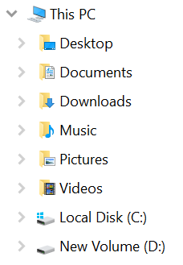
Paths
The location of a file in the file system
Represented in Java by the Path class
D:\input.txt
Path path = Paths.get("D:\\input.txt");
Root folder
D:\
input.txt
other files
<number>

Slide 28

Files
Provides static methods for creating streams
Path path = Paths.get("D:\\input.txt");
try (BufferedReader reader = Files.newBufferedReader(path)) {
// TODO: work with file
} catch (IOException e) {
// TODO: handle exception
}
<number>

Slide 29

Files (2)
Provides utility methods for easy file manipulation
Path inPath = Paths.get("D:\\input.txt");
Path outPath = Paths.get("D:\\output.txt");
List<String> lines = Files.readAllLines(inPath);
Files.write(outPath, lines);
// TODO: handle exceptions
<number>

Slide 30

Problem: Sort Lines
Read a text file and sort all lines
Write the result to another text file
Use Paths and Files classes
C
A
B
D
…
A
B
C
D
…
<number>

Slide 31
Solution: Sort Lines
Path path = Paths.get("D:\\input.txt");
Path output = Paths.get("D:\\output.txt");
try {
List<String> lines = Files.readAllLines(path);
Collections.sort(lines);
Files.write(output, lines);
} catch (IOException e) {
e.printStackTrace();
}
Don't use for large files
<number>

Slide 32

File Class in Java
Easily Working With Files

Slide 33
File Class in Java
Provides methods for quick and easy manipulation of files
import java.io.File;
File file = new File("D:\\input.txt");
boolean isExisting = file.exists();
long length = file.length();
boolean isDirectory = file.isDirectory();
File[] files = file.listFiles();
<number>

Slide 34
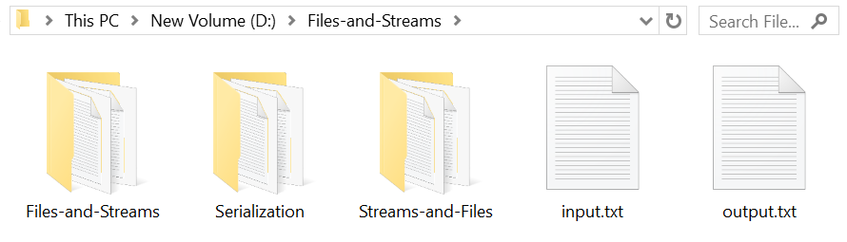
Problem: List Files
Print names and sizes of all files in "Files-and-Streams"
directory
Skip child directories
input.txt: [size in bytes]
output.txt: [size in bytes]
<number>

Slide 35

Solution: List Files
if (file.exists()) {
if (file.isDirectory()) {
File[] files = file.listFiles();
for (File f : files) {
if (!f.isDirectory()) { System.out.printf("%s: [%s]%n", f.getName(), f.length());
}
}
}
}
<number>

Slide 36
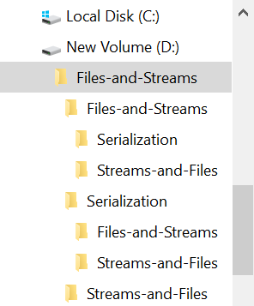
Problem: List Nested Folders
You are given a folder named "Files-and-Streams"
List all folder names, starting with the root
Print folder count on the last line (including the root)
…
Streams-and-Files
Serialization
Streams-and-Files
[count] folders
<number>

Slide 37
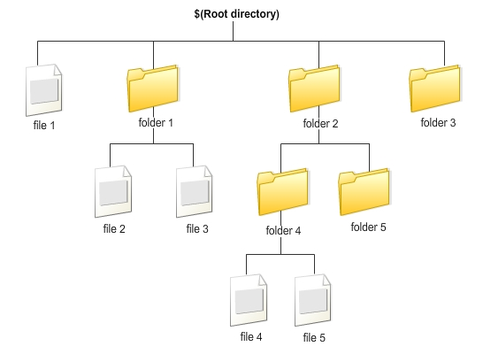
Solution: Nested Folders
String path = "D:\\Files-and-Streams";
File root = new File(path);
Deque<File> dirs = new ArrayDeque<>();
dirs.offer(root);
// continue…
<number>

Slide 38
Solution: Nested Folders (2)
int count = 0;
while (!dirs.isEmpty()) {
File current = dirs.poll();
File[] nestedFiles = current.listFiles();
for (File nestedFile : nestedFiles)
if (nestedFile.isDirectory())
dirs.offer(nestedFile);
count++;
System.out.println(current.getName());
}
System.out.println(count + " folders");
<number>

Slide 39



Serialization
Serializing and Deserializing Objects

Slide 40
Serialization
Save objects to a file
List<String> names = new ArrayList<>();
Collections.addAll(names, "Mimi", "Gosho");
FileOutputStream fos = new FileOutputStream(path);
ObjectOutputStream oos = new ObjectOutputStream(fos);
oos.writeObject(names);
// TODO: handle exceptions
Save objects to .ser file
<number>

Slide 41
Deserialization
Load objects from a file
FileInputStream fis =
new FileOutputStream(path);
ObjectInputStream oos =
new ObjectInputStream(fis);
List<String> names =
(List<String>) oos.readObject();
// TODO: handle exceptions
<number>

Slide 42

Serialization of Custom Objects
Custom objects should implement the Serializable interface
class Cube implements Serializable {
String color;
double width;
double height;
double depth;
}
<number>

Slide 43
Problem: Serialize Custom Object
Create a Cube class with color, width, height and depth
Create a cube – color: "green", w: 15.3, h: 12.4 and d: 3
<number>

Slide 44
Solution: Serialize Custom Object
class Cube implements Serializable {
String color;
double width;
double height;
double depth;
}
<number>

Slide 45
Solution: Serialize Custom Object (2)
String path = "D:\\save.ser";
try (ObjectOutputStream oos = new ObjectOutputStream( new FileOutputStream(path))) {
oos.writeObject(cube);
} catch (IOException e) {
e.printStackTrace();
}
<number>

Slide 46

Summary
…
…
…
Streams are used to transfer data
Two main types of streams
Input Streams
Output Streams
Buffered streams boost performance
Streams can be chained together
You can save objects state into a file
<number>
Notes:
© Software University Foundation – http://softuni.org
This work is licensed under the Creative Commons Attribution-NonCommercial-ShareAlike license.
<number>

Slide 47
https://softuni.bg/trainings/courses
Notes:
© Software University Foundation – http://softuni.org
This work is licensed under the Creative Commons Attribution-NonCommercial-ShareAlike license.
<number>

Slide 48












SoftUni Diamond Partners

Slide 49




SoftUni Organizational Partners

Slide 50




Trainings @ Software University (SoftUni)
Software University – High-Quality Education and Employment Opportunities
softuni.bg
Software University Foundation
http://softuni.foundation/
Software University @ Facebook
facebook.com/SoftwareUniversity
Software University Forums
forum.softuni.bg
Notes:
© Software University Foundation – http://softuni.org
This work is licensed under the Creative Commons Attribution-NonCommercial-ShareAlike license.
<number>

Slide 51

License
This course (slides, examples, demos, videos, homework, etc.) is licensed under the "Creative Commons Attribution-NonCommercial-ShareAlike 4.0 International" license
<number>
Notes:
© Software University Foundation – http://softuni.org
This work is licensed under the Creative Commons Attribution-NonCommercial-ShareAlike license.
<number>

